Slide 1

Encryption

Slide 2
Intuitive Model I
Encryption function/algorithm E
Decryption function/algorithm D
Encryption key k
Decryption key k’
Message space (usually binary strings)
For every message m: D_{k’}(E_{k}(m)) = m

Slide 3
Intuitive Model II
Two legitimate users
Reliable communication link
Alice
Bob
Shared scheme:
Domains, algorithms, keys
Shared scheme:
Domains, algorithms, keys
Eve
Eavesdropping adversary

Slide 4
Some Terms
Encryption function/algorithm E
Plaintext – the message prior to encryption
Ciphertext – the message after encryption
The whole system – encryption scheme or cipher
Symmetric key scheme – encryption scheme in which k=k’

Slide 5
Adversary Model I
Several Possible models
Minimal information
Eve knows E,D
(Explanation: A5 and RC4 history)
Eve knows the message space (“easy”)
Eve knows E_{k}(m)
Eve does not have k’

Slide 6
Adversary Model II
Eavesdropping
Eve receives E_{k}(m₁),…,E_{k}(m_{n})
Known plaintext
Eve receives pairs (m₁, E_{k}(m₁)),…,(m_{n},E_{k}(m_{n}))
Chosen plaintext
Eve chooses plaintexts m₁,…,m_{n}
Eve receives pairs E_{k}(m₁),…,E_{k}(m_{n})
Goal: decrypt E_{k}(m), ∀i m≠m_{i}

Slide 7
Adversary Model III
Models with more information for attacker
More difficult to create
Chosen ciphertext
Eve chooses E_{k}(m₁),…,E_{k}(m_{n})
Eve receives m₁,…,m_{n}
Key leakage (side-channels)
In addition to any model, Eve receives E_{k}(m) and f(m) for some “leakage” function f

Slide 8
Active attacks
Adversary may actively change ciphertext
Hopes that resulting plaintext helps
Full solution only in lesson on integrity

Slide 9
Bad Ciphers I
Example I: Shift cipher
Plaintext domain: alphabet, e.g. a,…,z
Alphabet size m
Encoded as 0,…,m-1, e.g. 0,…,25
Key domain: {0,…,m – 1}
Encryption ciphertext=plaintext + key mod m
Decryption plaintext=ciphertext-key mod m
Attack – brute force search on key space

Slide 10
Bad Ciphers II
Example II: Substitution cipher
Plaintext domain: alphabet, e.g. a,…,z
Key domain: permutation on alphabet, e.g. a→v, v→j, j→p,…
Encryption: ciphertext= permutation (plaintext)
Decryption: plaintext= permutation⁻¹ (plaintext)
Number of keys: m!

Slide 11
Bad Ciphers III
Attack – ciphertext doesn’t hide plaintext frequencies
In English
Example: e is the most frequent letter: 13% of all letters on average, followed by t, a, o
There are known frequencies for two or more letters.
Attacker matches frequencies of ciphertext with expected frequencies

Slide 12
Bad Ciphers IV
Hill’s cipher
Plaintext domain: m-bit binary vector p
Key – m×m binary invertible matrix A
Encryption c=Ap
Decryption p=A⁻¹c
Chosen plaintext attack – choose basis P=p₁,…,p_{m}
Receive ∀i (p_{i},c_{i}) – C=c₁,…,c_{m}
Solve AP=C➔A=P⁻¹C

Slide 13
Bad Ciphers V
Known plaintext attack – find m linearly independent vectors in p₁,…,p_{n}, n≥m
Solve linear system in (p_{i},c_{i})

Slide 14
Attacks so far
Exploit
Small key space
Patterns in plaintext reflected in ciphertext
Linearity
Are all encryption schemes vulnerable to attacks?

Slide 15
Perfect Cipher I
Intuition:
Ciphertext gives no information on plaintext beyond what is already known
Let P be random variable defining plaintexts
Pr[P=p] is the probability that p is a plaintext
Let C be random variable defining ciphertexts
Pr[C=c] is the probability that c is a ciphertext

Slide 16
Perfect Cipher II
Definition: A cipher is perfect if for any plaintext p and any ciphertext c
Pr[P=p | C=c] = Pr[P=p]
Probability of plaintexts is independent of encryption scheme
Probability of ciphertexts depends on the plaintexts and on the choice of keys

Slide 17
One Time Pad I
Intuition:
Plaintext space - {0,1}^{n}
Key space - {0,1}^{n}
The scheme is symmetric, key k is chosen at random
E_{k}(p) = c = p ⊕ k
D_{k}(c) = c ⊕ k = p

Slide 18
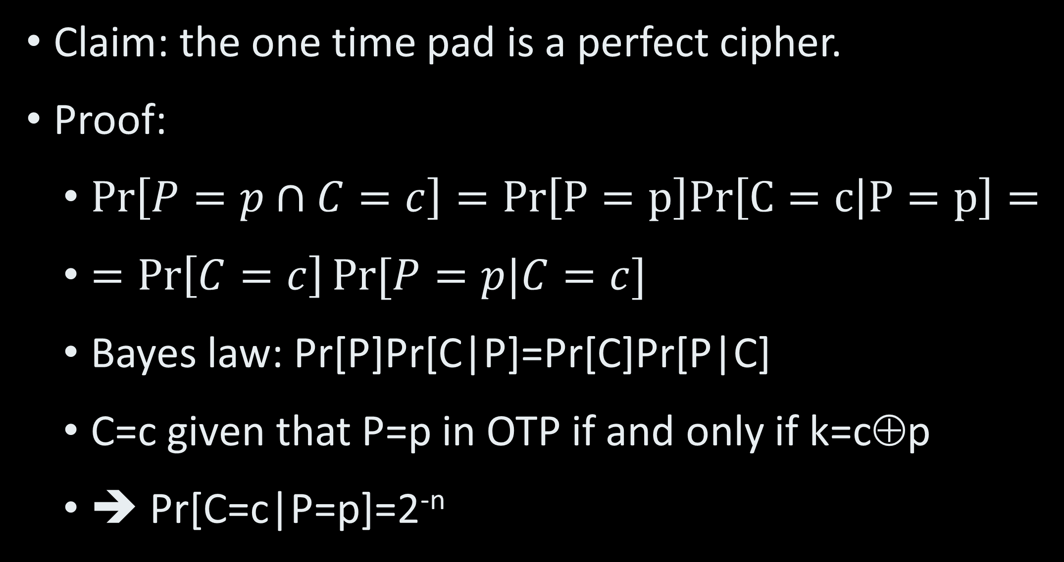
One Time Pad II
Claim: the one time pad is a perfect cipher.
Proof:
$\operatorname{Pr}\left[P=p∩C=c\right]=Pr\left[P=p\right]Pr\left[C=c | P=p\right]=$
$=\operatorname{Pr}\left[C=c\right]Pr⁡[P=p|C=c]$
Bayes law: Pr[P]Pr[C|P]=Pr[C]Pr[P|C]
C=c given that P=p in OTP if and only if k=c⊕p
➔ Pr[C=c|P=p]=2^{-n}

Slide 19
One Time Pad III
Proof(cont.)
Law of total probability
Pr[C=c]=∑_{P=p} Pr[C=c ∩ P=p]=
=∑_{P=p} Pr[C=c|P=p] Pr[P=p]
➔Pr[C=c]= ∑_{P=p} 2^{-n} Pr[P=p]= 2^{-n} ∑_{P=p} Pr[P=p]
=2^{-n}
Assign in Bayes: Pr[P] 2^{-n} = 2^{-n} Pr[P|C]
➔ OTP is a perfect cipher

Slide 20
One Time Pad IV
Problem: size of key space
Theorem [Shannon]: A cipher is perfect only if its key space is at least the size of its message space.
A one-time pad must not be used twice!
If c₁=p₁⊕k and c₂=p₂⊕k then
c₁⊕c₂=p₁⊕p₂
Ciphertexts provide a lot of information on plaintexts

Slide 21
Computational Hardness I
Alternative to perfect ciphers
Goal
Encryption and decryption computationally “easy” given key
“Breaking cipher” is computationally “hard” without key
Measures of hardness
Running time
Hardware (circuit) size
Storage size

Slide 22
Computational Hardness II
Different definitions of easy and hard
Asymptotic definitions
Easy = polynomial time computation in size of input
Hard = super-polynomial time in input size
Concrete numbers for adversary (this course)
Easy – less than 2⁶⁴ clock cycles / logic gates
Hard – more than 2¹²⁸ cycles / gates (old number was 2⁸⁰)

Slide 23
Generic Attacks I
Exhaustive search
Given ciphertext c, run D_{k}(c) for all keys k
Type: ciphertext only (eavesdropping)
Time: 2^{|k|} decryptions per ciphertext
Storage: constant

Slide 24
Generic Attacks II
How can time be reduced?
More hardware
Tradeoffs between time and memory/hardware
Quantum computation
Grover’s algorithm works in 2^{|k|/2}

Slide 25
Generic Attacks III
Preprocessing model
AKA offline/online attack
Long computation independently of key
Short computation when key is used

Slide 26
Generic Attacks IV
Example: table lookup
Type: chosen plaintext
Attacker chooses plaintext p
Preprocessing: attacker constructs table of E_{k}(p) for all k
Online – attacker requests encryption of p, receives ciphertext and searches table
Time: offline 2^{|k|} encryptions, online constant
Storage: 2^{|k|} ciphertexts

Slide 27
Definitions
Encryption requires two properties
Correctness – for all plaintext p, encryption key k and matching decryption key k’: D_{k’}(E_{k}(p))=p
Security
Tricky!
Not finding key k is too weak!
Not decrypting random ciphertext is too weak!

Slide 28
Semantic Security
Standard security definition
“Game” between challenger and adversary
Challenger chooses key
Adversary chooses two plaintexts m₀, m₁
Challenger chooses random b∈{0,1} and sends E_{k}(m_{b}) to adversary
Adversary returns b’ and wins if b=b’ with probability significantly more than 0.5

Slide 29
Example
Is One-Time pad semantically secure?
Is OTP with two uses of pad semantically secure?

